Slide 1
DIVERSITY MANAGEMENT

Slide 2
Diversity
Encompasses all forms of individual
differences including:
culture, gender, age, ability, religion,
personality, social status, and sexual
orientation

Slide 3
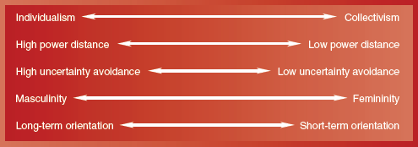
Understanding Cultural Differences
HOFSTEDE’S DIMENSIONS

Slide 4
Developing Cross-Cultural Sensitivity
Cultural sensitivity training
Cross-cultural task forces/teams
Global view of human resource functions
Planning
Recruitment and Selection
Compensation
Training and Development

Slide 5
Diversity Statistics for the Workplace
Ethnic
2020 Workforce:
68% white non-Hispanic
14% Hispanic
11% African-American
5% Asian
Gender
2020 Workforce:
50% male
50% female
Age
By 2030, people over 65 will comprise 20% of the
population.
Ability
An estimated 50 million disabled live in the U.S.; their
unemployment rate exceeds 50%.

Slide 6
& OBSTACLES AT WORK
WOMEN
Comprise over 60% of the workforce
Earn 49% of all doctorates
Earn 60% of master’s degrees
Earn 58% of undergraduate degrees
BUT
Little increase in number of women CEOs.
Earn 81% of what male counterparts do.
Encounter the glass ceiling in the workplace

Slide 7
Diversity’s Benefits & Problems
BENEFITS PROBLEMS
•Attracts and retains the best
talent
Improves marketing efforts
Promotes creativity and
innovation
•Results in better problem
solving
•Enhances organizational
flexibility
Resistance to change
Lack of cohesiveness
Communication problems
Interpersonal conflicts
Slower decision making

Slide 8
Need for Cultural Training
To survive and succeed expatriates require training in three matters: culture, language and practical day to day matters.
For organisations, it is a big challenge to prepare expatriates for the country other than there home country.
According to Harris and Moran, cultural differences between countries could be examined along the following dimensions:

Slide 9
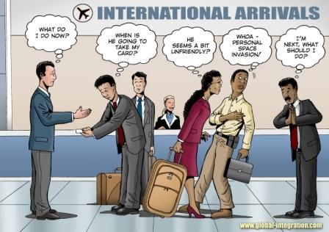
Need for Cultural Training
Sense of self and space
Language
Dress & Appearance
Food, eating habits
Time consciousness
Relationships
Values and norms
Beliefs and attitudes
Mental processes and learning
Work habits and practices

Slide 10
International training and development
1) Cultural awareness programme
2) Preliminary visits
3) Language instruction
4) Practical assistance with day to day matters
5) Health and safety
6) International labour laws

